Slide 1
NGRX IS:
An Angular implementation of Redux

Slide 2
Why do we care about Redux?
If you experience the following symtoms you might need Redux:
A feeling that the state is spread out
There are issues with updating state
Some things keep changing the state but you don't know who or what

Slide 3
Solution: a single source of truth with reducers guarding state change. Also enhanced predictability with immutable data structures

Slide 4
CORE CONCEPTS

Slide 5
Store, our data store
Reducer, a function that takes state + action and produces a new state
Selector, selects a slice of state
Action, an intention of state change
Action creator, produces an intention that may include data

Slide 6
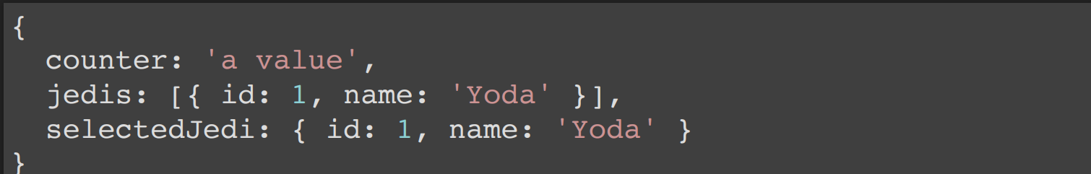
Typical Store content, just an object

Slide 7
REDUCER NEW STATE = STATE + ACTION

Slide 8
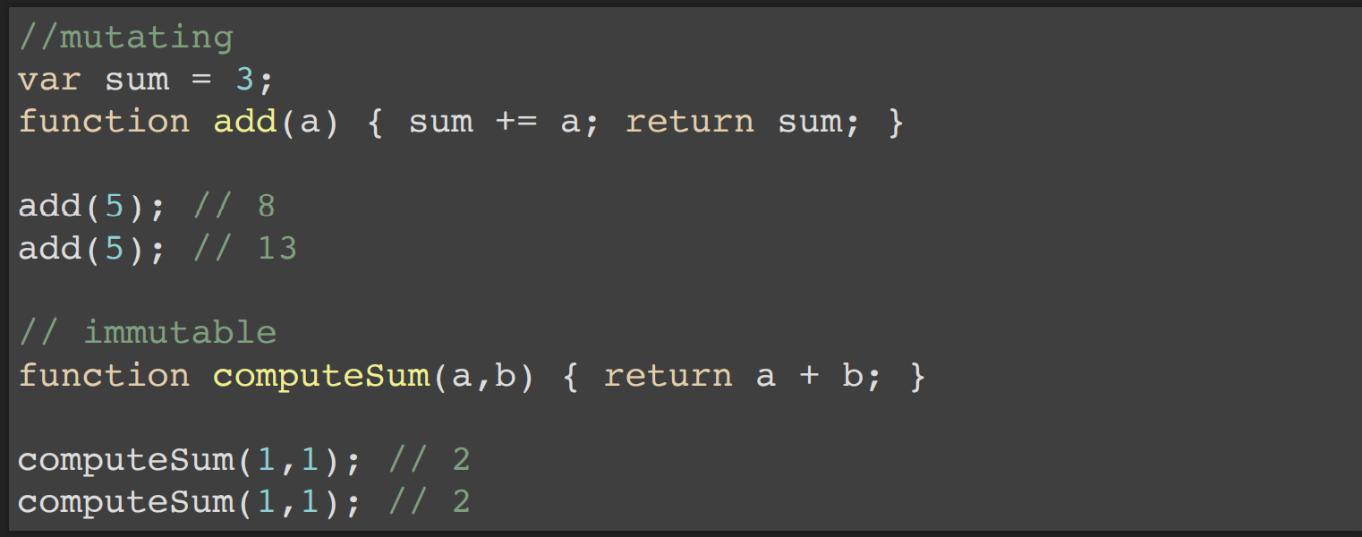
Mathematical function, immutable, just a calculation

Slide 9
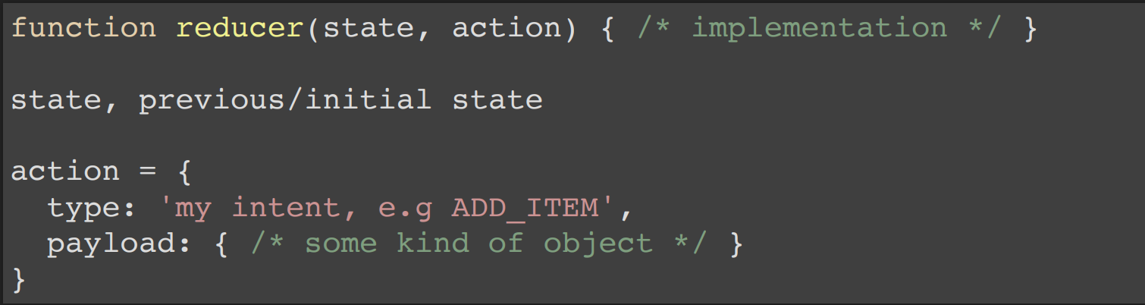
A reducer looks like the following:

Slide 10
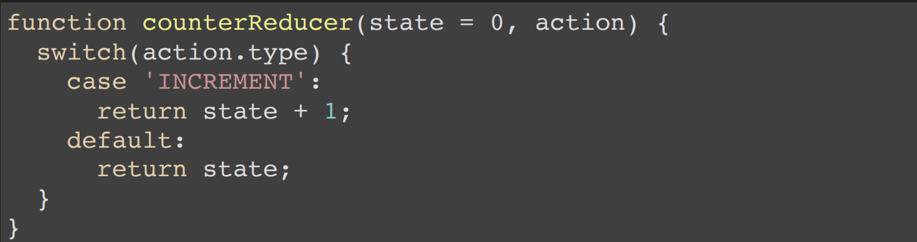
state + 1, instead of state +=1, immutable

Slide 11
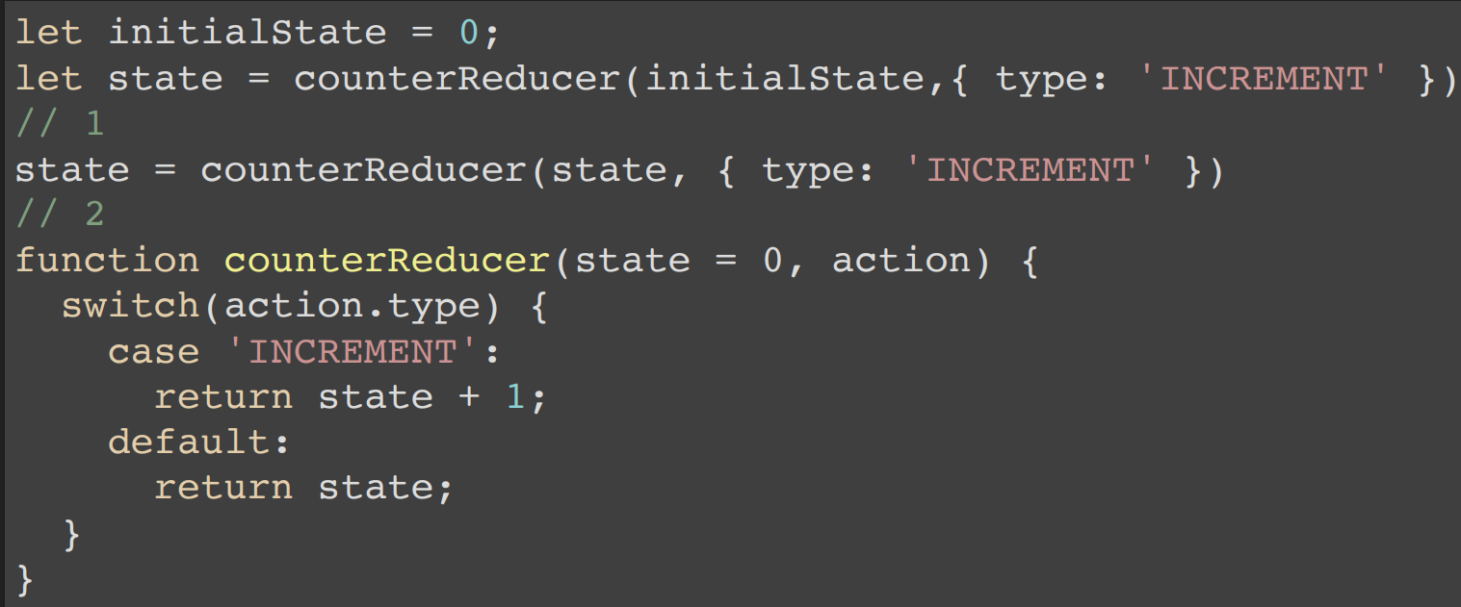
Usage

Slide 12
A simple store
class Store {
constructor(initialState) { this.state = initialState; }
dispatch(action) {
this.state = calc(this.state, action);
}
calc(state, action) {
return {
counter: counterReducer(state.counter, action)
}
}
}

Slide 13
Usage, store
let store = new Store({ counter: 0 });
store.dispatch({ type: 'INCREMENT' });

Slide 14
Action, an object with a property 'type' and 'payload’
'type' = intent
'payload' = the change
{ type: ‘INCREMENT', payload: {} }
{ type: 'ADD_USER', payload: { id: 1, name: ‘user_name' } }

Slide 15
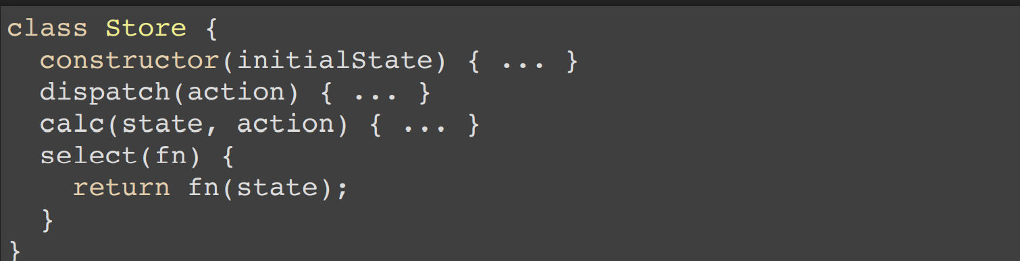
Selector, slice of state

Slide 16
Selector, definitions
const getCounter = (state) => state.counter;

Slide 17
OVERVIEW OF LIBRARIES

Slide 18
@ngrx/store, the store
@ngrx/store-devtools, a debug tool that helps you track dispatched actions
@ngrx/effects, handles side effects
@ngrx/router-store, lets you put the routing state in the store
@ngrx/entites, handles records
@ngrx/schematics

Slide 19
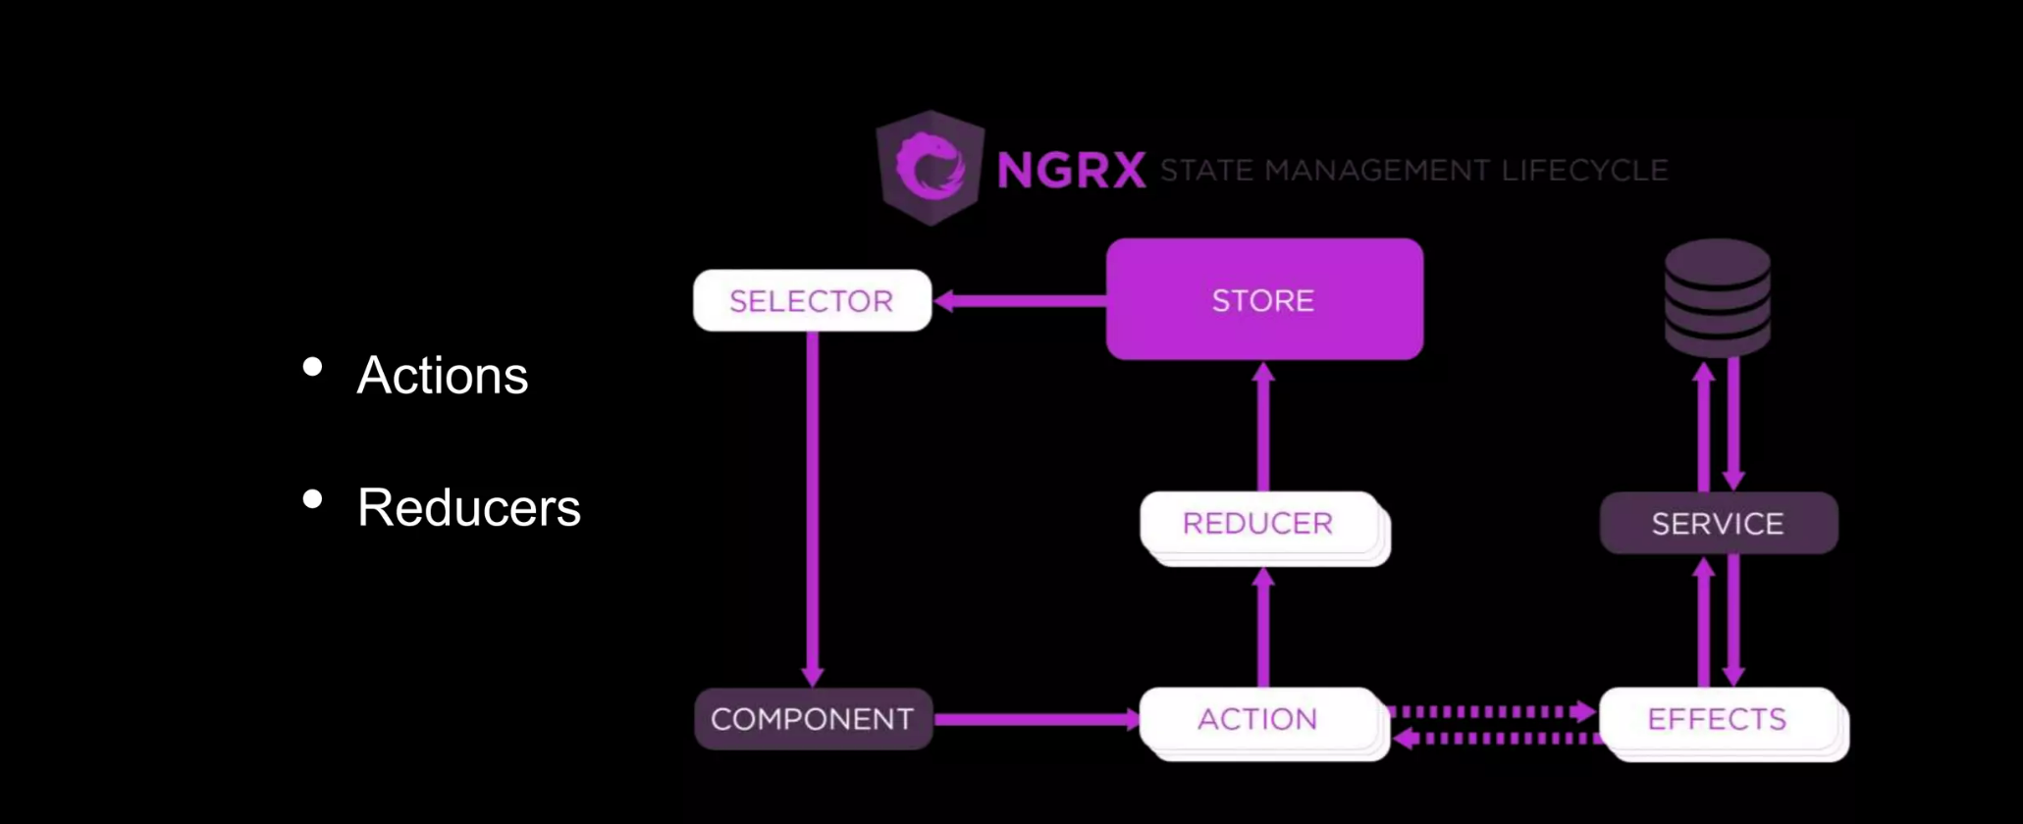

Slide 20
STORE
WHERE THE STATE LIVES

Slide 21
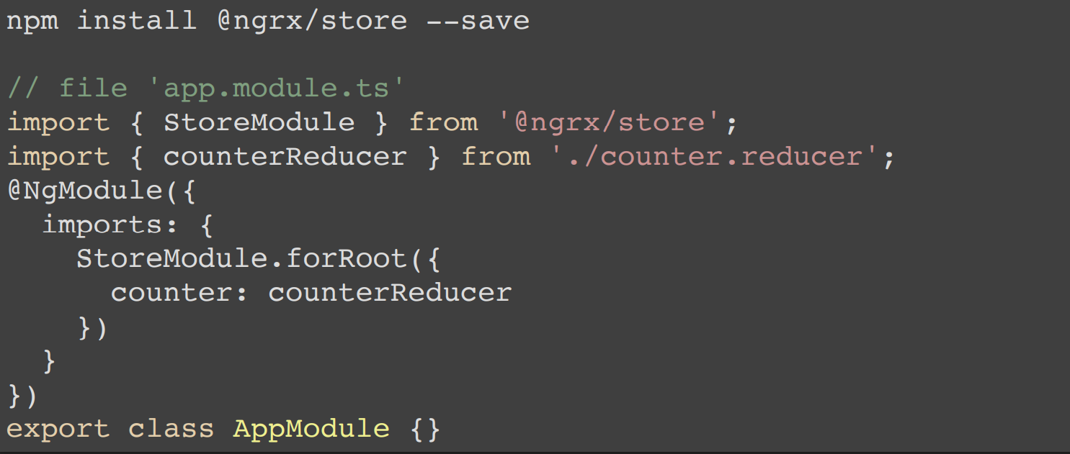
INSTALLATION AND SET UP

Slide 22
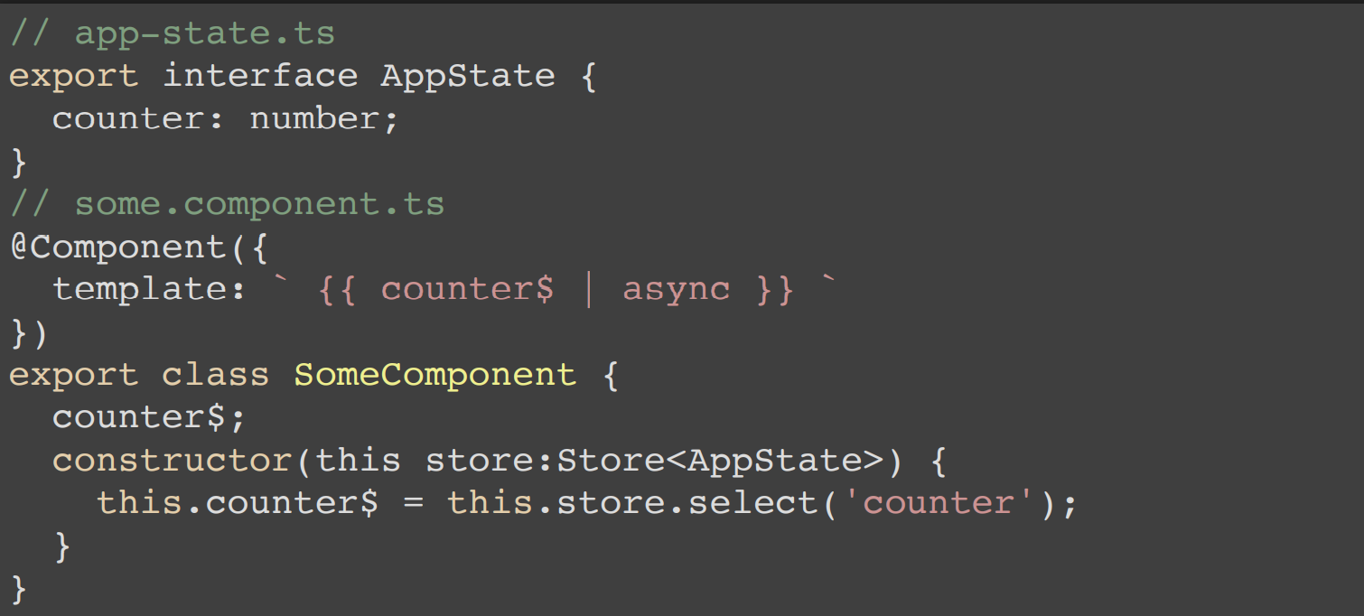
SHOW DATA FROM STORE

Slide 23
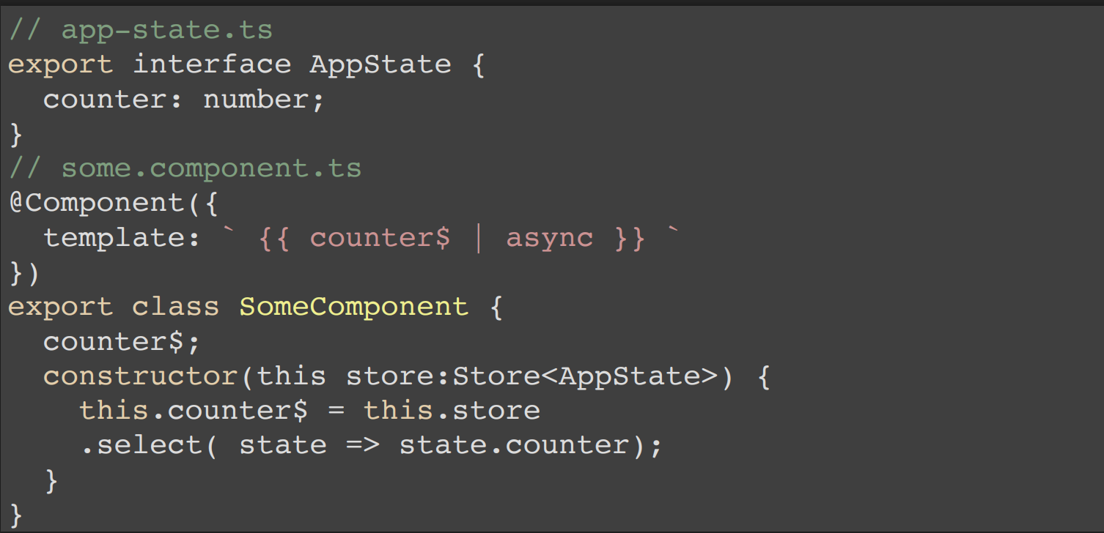
SHOW DATA FROM STORE, SELECTOR FUNCTION

Slide 24
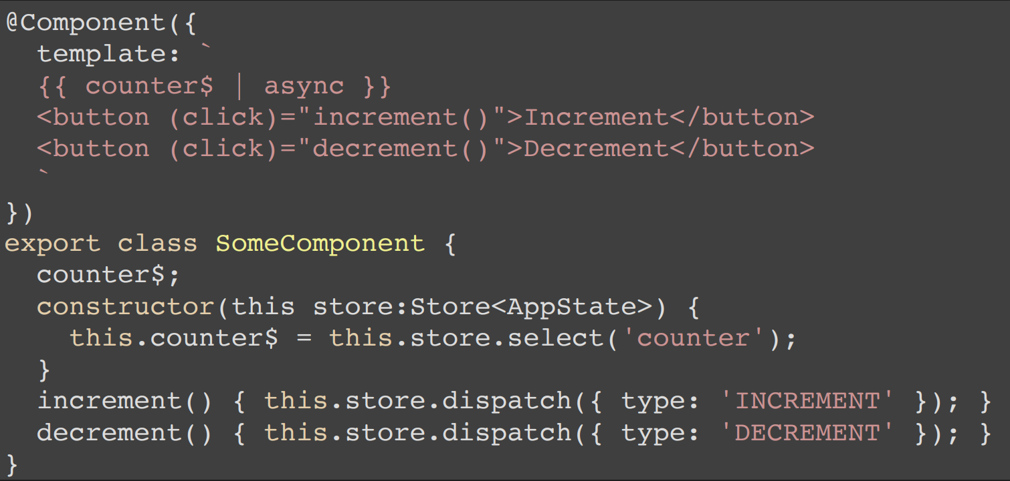
DISPATCH DATA

Slide 25
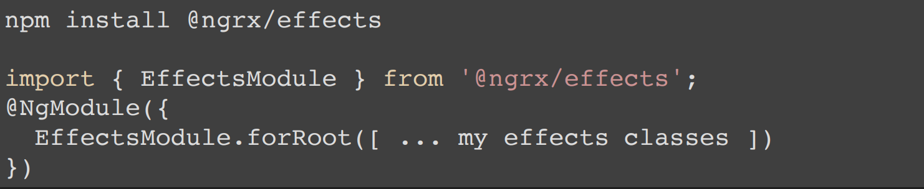
NGRX EFFECTS
INSTALLATION AND SETUP

Slide 26
What kind of behaviour do we want?
Set a loading flag, show spinner
Do AJAX call
Show fetched data or error
Set loading flag to false, hide spinner

Slide 27
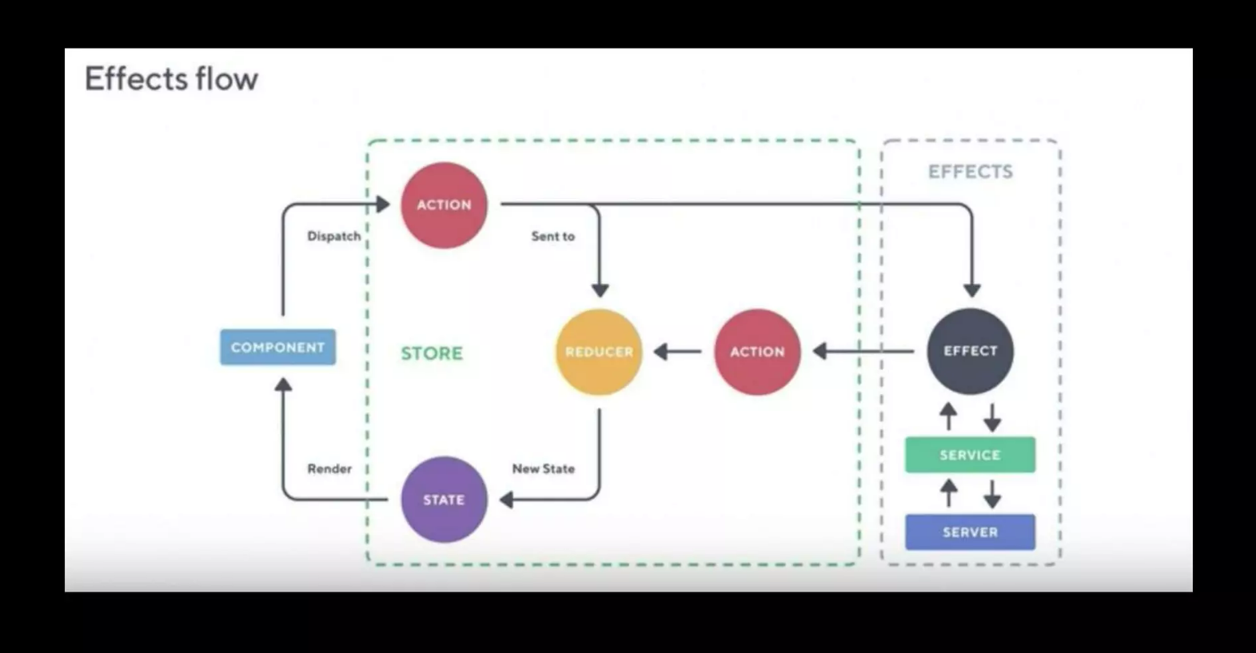

Slide 28
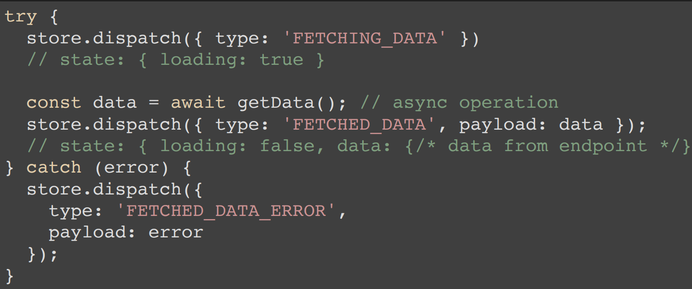
NGRX approach

Slide 29
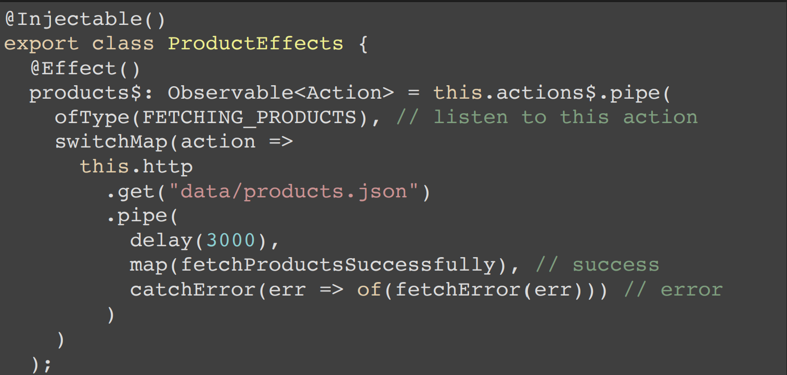
Effect - calling HTTP

Slide 30
